Slide 1
Clearing the Haze from Climate Models
Deep Learning for the Improvement of Cloud Identification

Slide 2
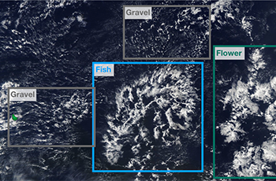
Problem Statement
Given a satellite image of clouds, determine whether it contains a specific cloud organization pattern
Notes:
The images were downloaded from NASA Worldview. Three regions, spanning 21 degrees longitude and 14 degrees latitude, were chosen. The true-color images were taken from two polar-orbiting satellites, TERRA and AQUA, each of which pass a specific region once a day. Due to the small footprint of the imager (MODIS) on board these satellites, an image might be stitched together from two orbits. The remaining area, which has not been covered by two succeeding orbits, is marked black.
Climate change has been at the top of our minds and on the forefront of important political decision-making for many years. We hope you can use this competition’s dataset to help demystify an important climatic variable. Scientists, like those at Max Planck Institute for Meteorology, are leading the charge with new research on the world’s ever-changing atmosphere and they need your help to better understand the clouds.
In this challenge, you will build a model to classify cloud organization patterns from satellite images. If successful, you’ll help scientists to better understand how clouds will shape our future climate. This research will guide the development of next-generation models which could reduce uncertainties in climate projections.

Slide 3
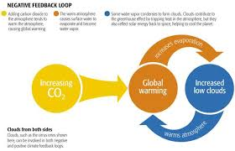
Importance
Climate change – increasingly driven by human intervention
How does cloud/climate feedback factor in with these rising
Notes:
. Just as clouds affect climate, changes in the climate affect clouds. This relationship is known as cloud-climate feedback. It is one of the most challenging research areas in climate science.

Slide 4
Methodology

Slide 5
Validation

Slide 6
Timeline

Slide 8
And if the headline is two lines long, it looks like this and gets a little smaller
This is the first point.
Here’s a second point. Let’s make it a longer one and see how it wraps
Example of a sub point.
Another sub point
Look, I’m a third point.
Subpoint example
Sub-sub point example the first
And the second

